Slide 1
Topic C: Radiation Tracking
Group: A9

Slide 2
Introduction:
IoT Data Generation:
Increases data volume and velocity.
Allows continuous monitoring of human activities, locations, health states, and communication patterns.
Sensor networks generate continuous data streams from various locations.
But,
Large data volume requires significant processing.
High velocity necessitates near real-time processing to avoid outdated data.

Slide 3
Project Objectives:
Setup and use a stream processing framework for large sensor data.
Utilize Safecast Radiation Measurements dataset (25.8 GB, millions of readings worldwide). Data includes radiation measurements in counts per minute (CPM), location (latitude, longitude), and time.
Populate a world map with Safecast dataset information.
Provide data operations: summarizing data, generating alerts for high radiation, and indicating radiation levels with colors.

Slide 4
Technical Tools used:
Python v3.12.0
Apache Kafka
Apache Flink
MapView**
Google Cloud
Docker
Dataset: SafeCast Radiation Measurements

Slide 5
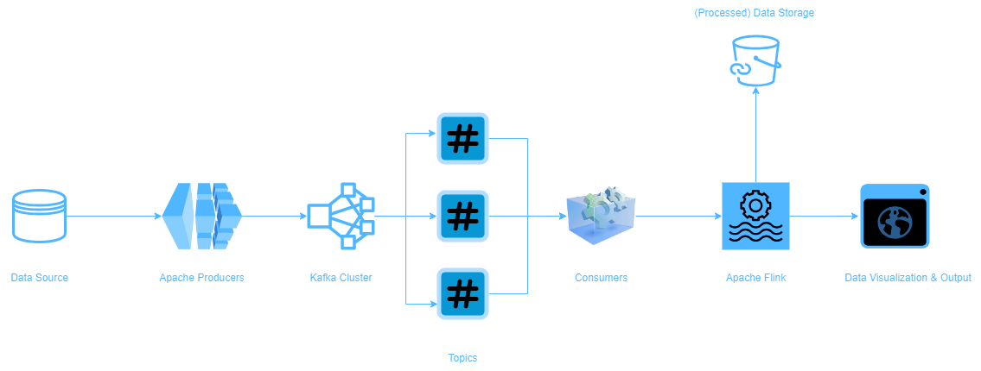
Architecture:

Slide 6
Tasks done until now:
Set up and configured Apache Kafka.
Implemented the data provider as a producer for Apache Kafka.
This data provider retrieves the radiation and location information from the Safecast dataset, and submits it to Kafka topic created.
Data is submitted keeping timestamps intact.
Submission speed is made configurable
Implemented a Kafka consumer to verify the producer progress.

Slide 7
Tasks to be done:
Implement Apache Flink as a data stream processor as an intermediate step between Producer and Consumer (Map).
Implement different processing such as handling of missing values, timestamp adjustments, etc
Implement a user friendly web-based GUI featuring the map and configuration means.
Implement an additional database to store all the processed data, for future references and applications.
Deploy the data through the GUI and populate a world map with radiation data, enabling different features in the map.

Slide 8
Challenges:
Choosing the right processing techniques
Using the best possible GUI for populating the map
Integrating Apache Flink with Kafka Producer

Slide 9
Thank You

